Slide 1
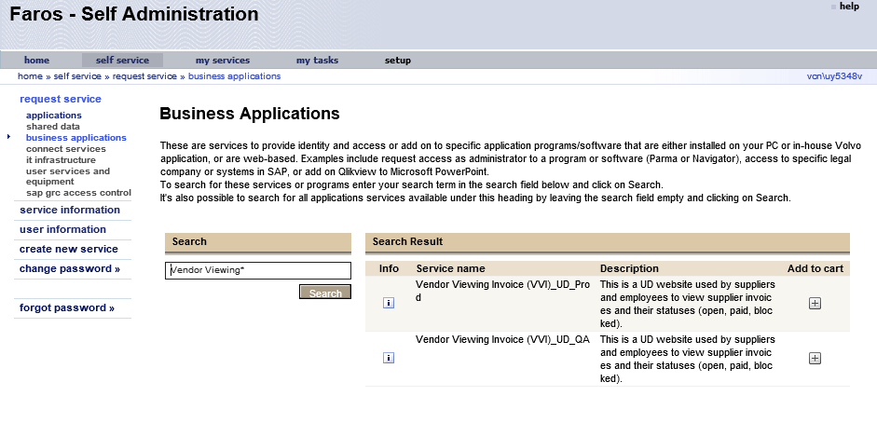
Request for employee access in Faros
You can find UD VVI under business applications in Faros.
Please search for Vendor Viewing* to find the service you want – production or QA.
Here is the link to UD VVI:

